Slide 1
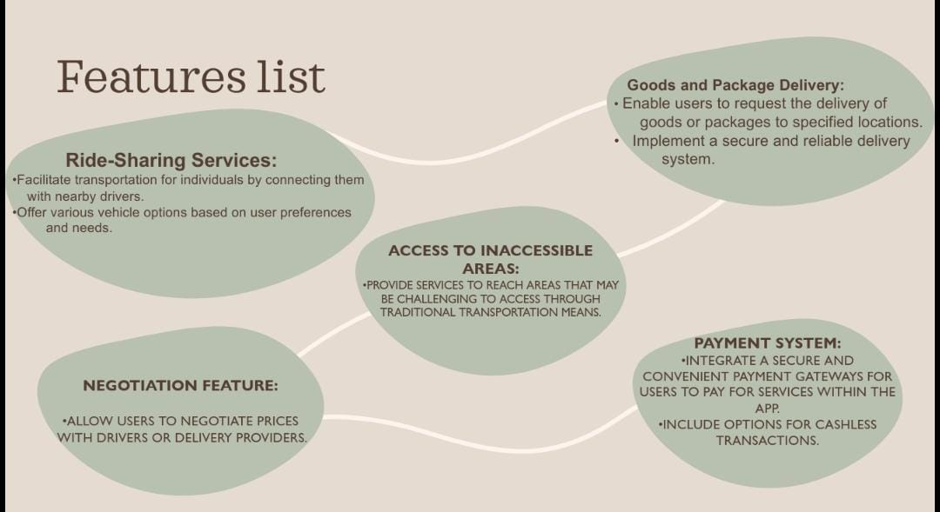

Slide 2
Figma Link:
https://www.figma.com/file/0EGaSvQEDN8iY3UrVWFZ8O/Untitled?type=whiteboard&t=VDKKW2O5nduZYSgn-1

Slide 3
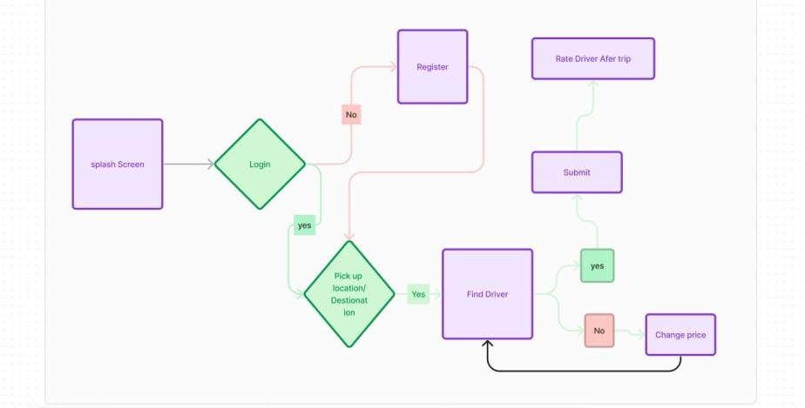
User Flow

Slide 4
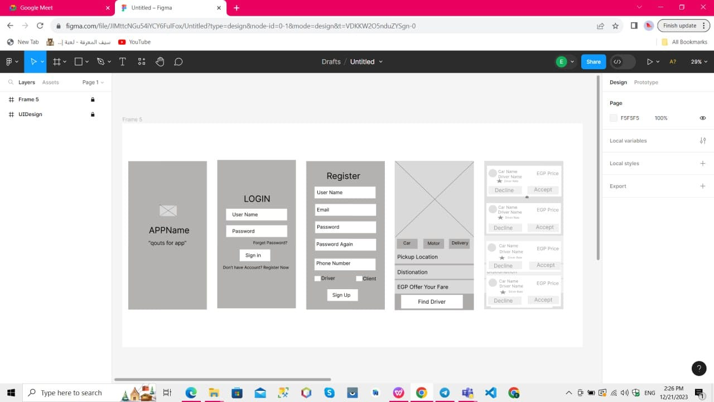

Slide 5
